Slide 1
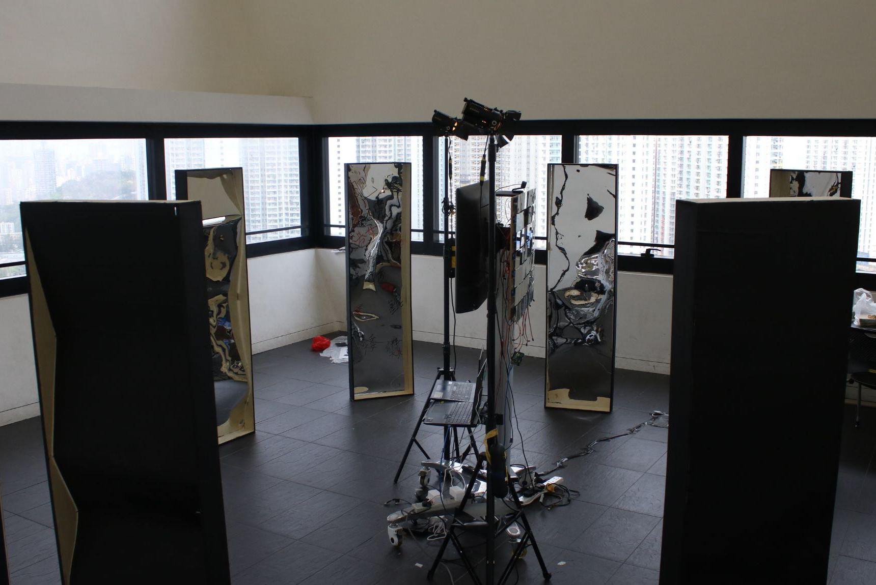
The Mirror Forest
Group 37 EVA
BScCMFYP
Notes:
Video→idea→how to build up this installation→explain part by part

Slide 2
Table of contents
01.
02.
03.
04.
Demo Video
Idea
Outcome
Reflection

Slide 3
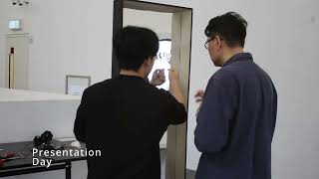
01.
Demo Video
Pitch deck
EVA

Slide 4
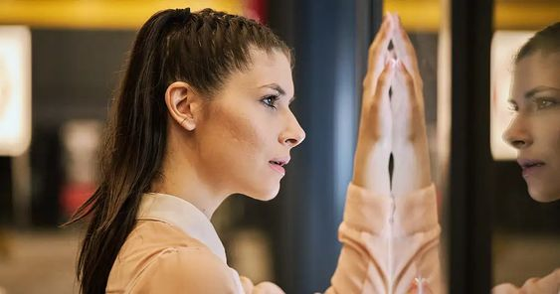
02.
Idea
Self-reflection, accept yourself
Pitch deck
EVA

Slide 5
Purpose
Providing a tool for visitors to face themselves.
Guiding visitors to think about their own problems.
Instilling the statement: “Your internal feelings are way more important than how others see you.”
Accepting your flaws. No one is perfect.

Slide 6
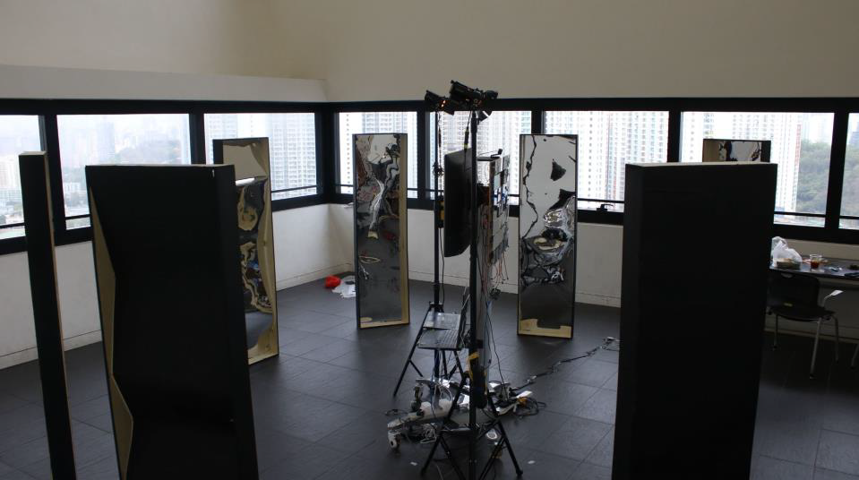
03.
Outcome
Pitch deck
EVA

Slide 7
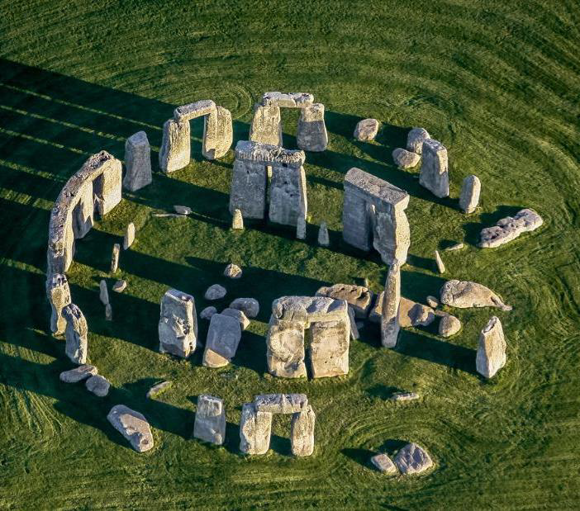
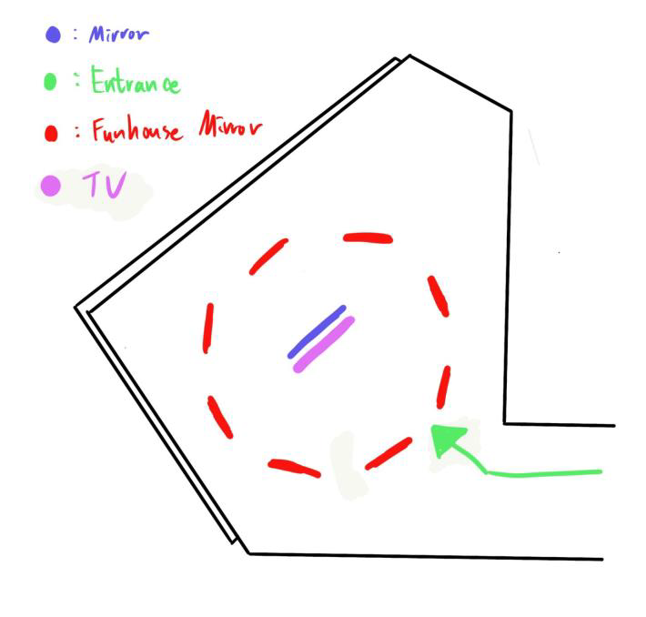
Overall Structure
Stonehenge
Creates a surrounded space in the order of arrangement
Notes:
Stonehenge, and surrounds a space in the order of arrangement and then puts the most surprising part in the middle to create importance. The funhouse mirror will be made into different shapes to bring out different messages. The middle part is Television and moving mirror. Also, there should be a expected path to led the visitor.

Slide 8
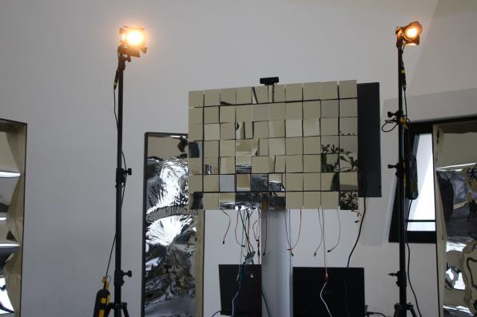
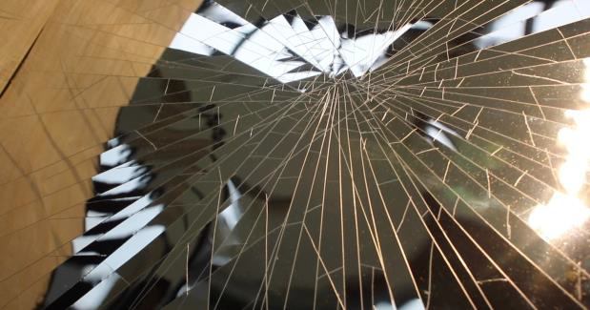
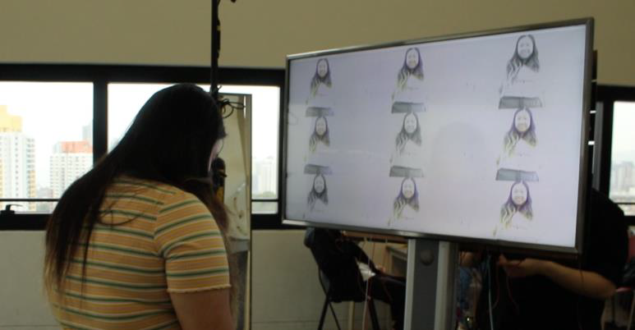
The Mirror Forest
Face-tracking Mirror
Outer Mirrors
TV Monitor

Slide 9
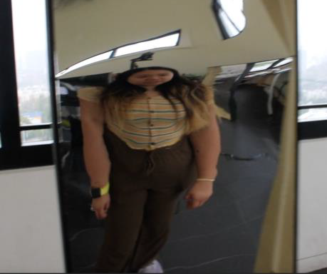
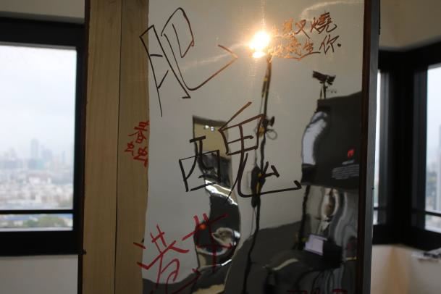
Outer Mirrors
Funhouse
Broken
Graffitied

Slide 10
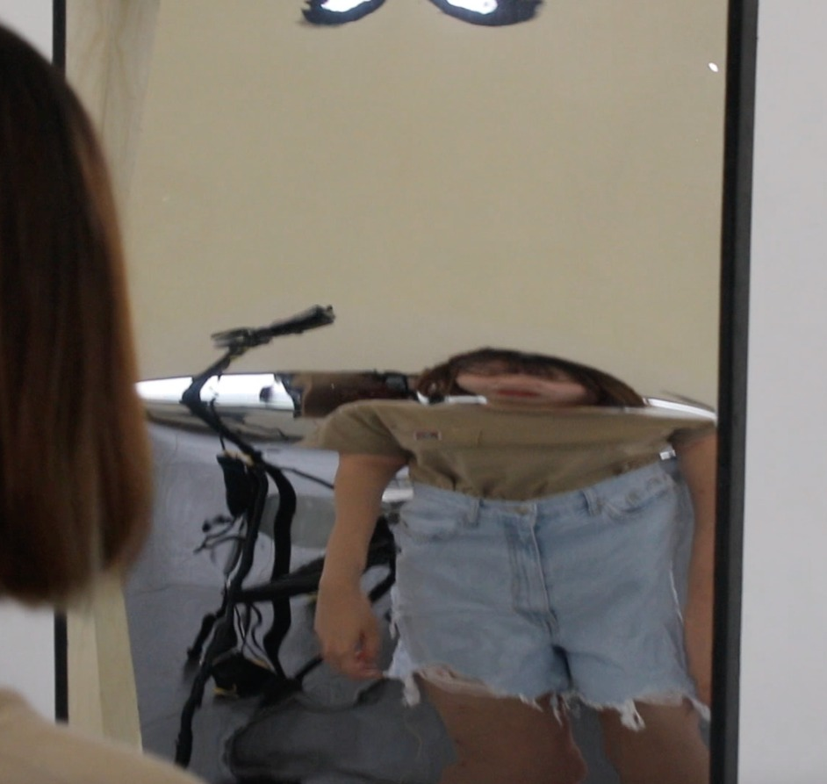
Funhouse Mirror
Image will be distorted
the visitor will see their bodies being pulled, split, and merged strangely

Slide 11

Broken Mirror
cracks on the mirror surface, including scratches and diffusion cracks formed by hitting.
visual effects and emotional associations to the visitor

Slide 12

Graffitied Mirror
words and sentences written on the mirror surface
come from the labels, dialogues, etc. encounter in daily life
derogatory and offensive and have stronger feelings and associations

Slide 13
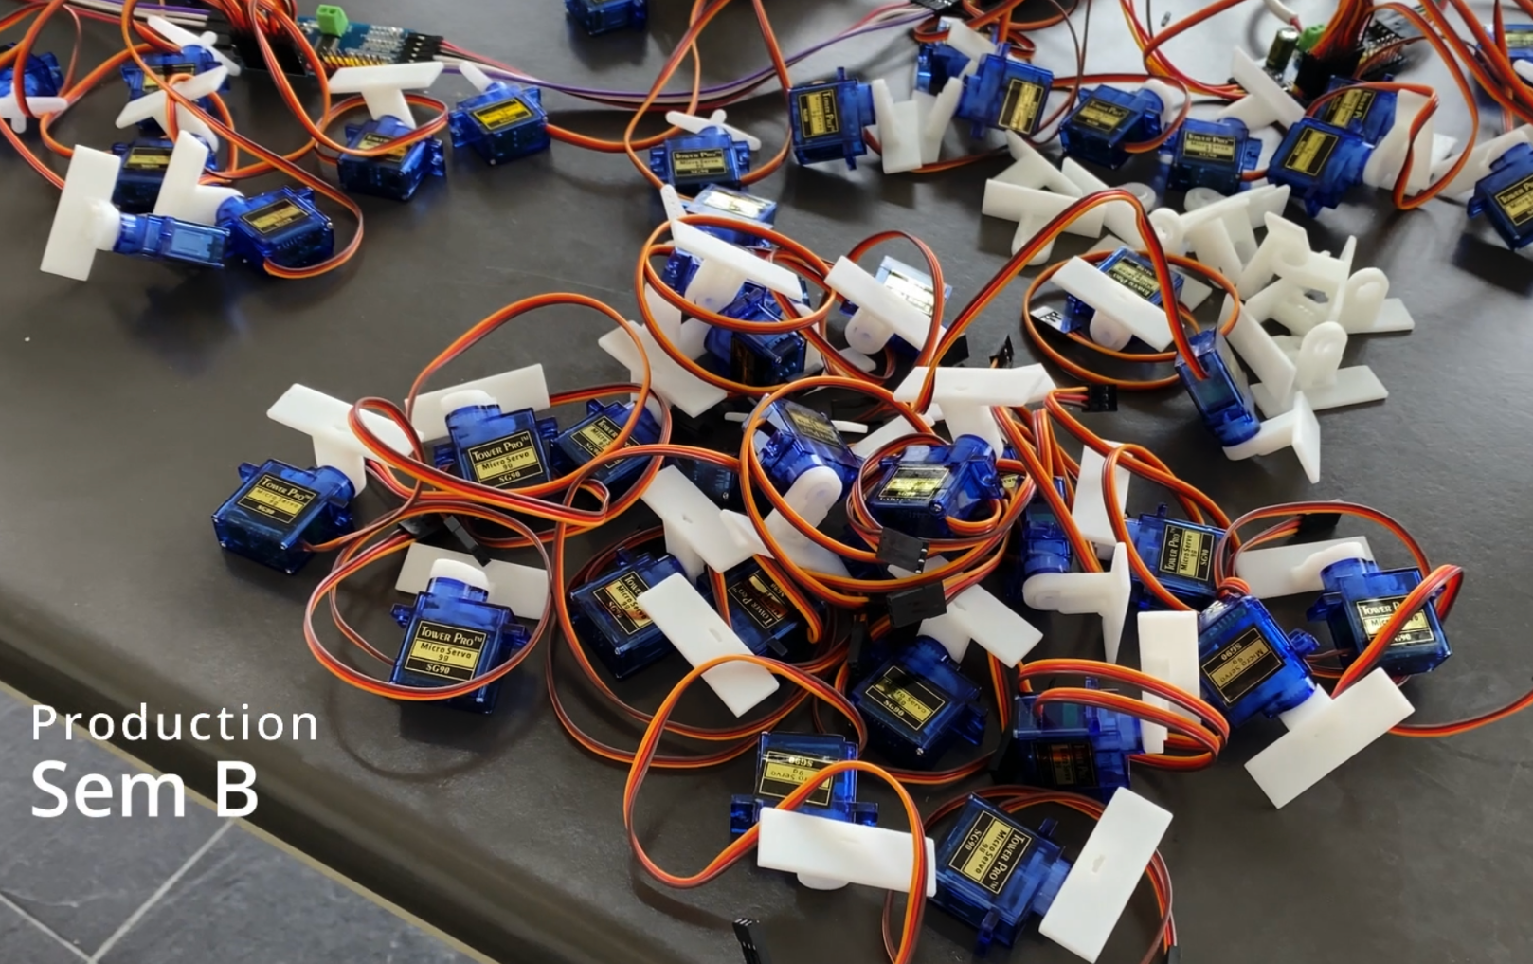
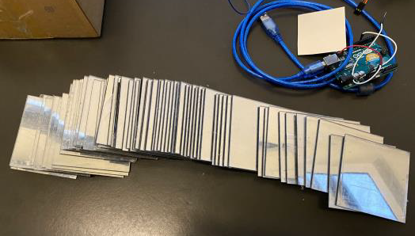
Face-tracking Mirror
Combination of 70 tiny mirrors
With servo motors and 3D prints
An interactive mirror following faces when moving

Slide 14
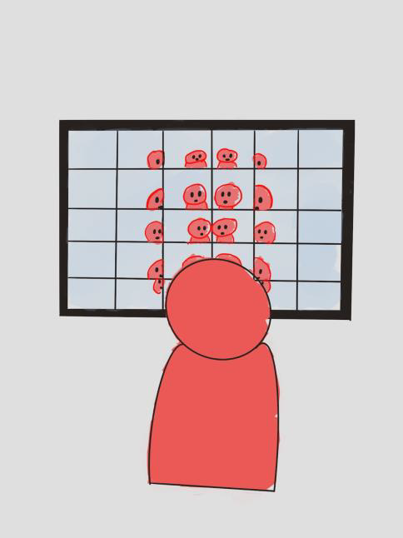
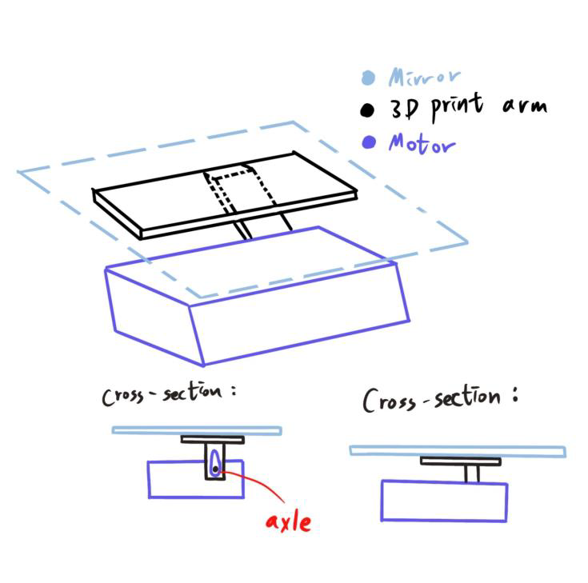
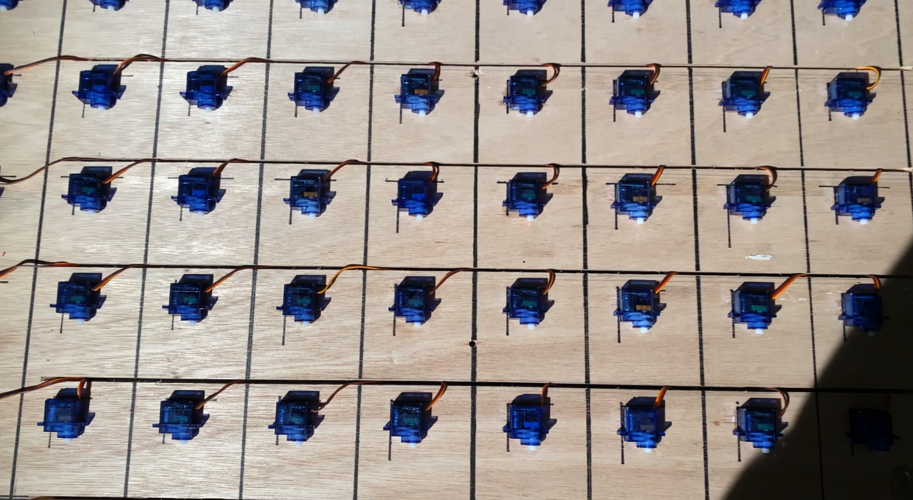
Mechanism
Using the rotating axis of servo
To control the angle of mirrors

Slide 15
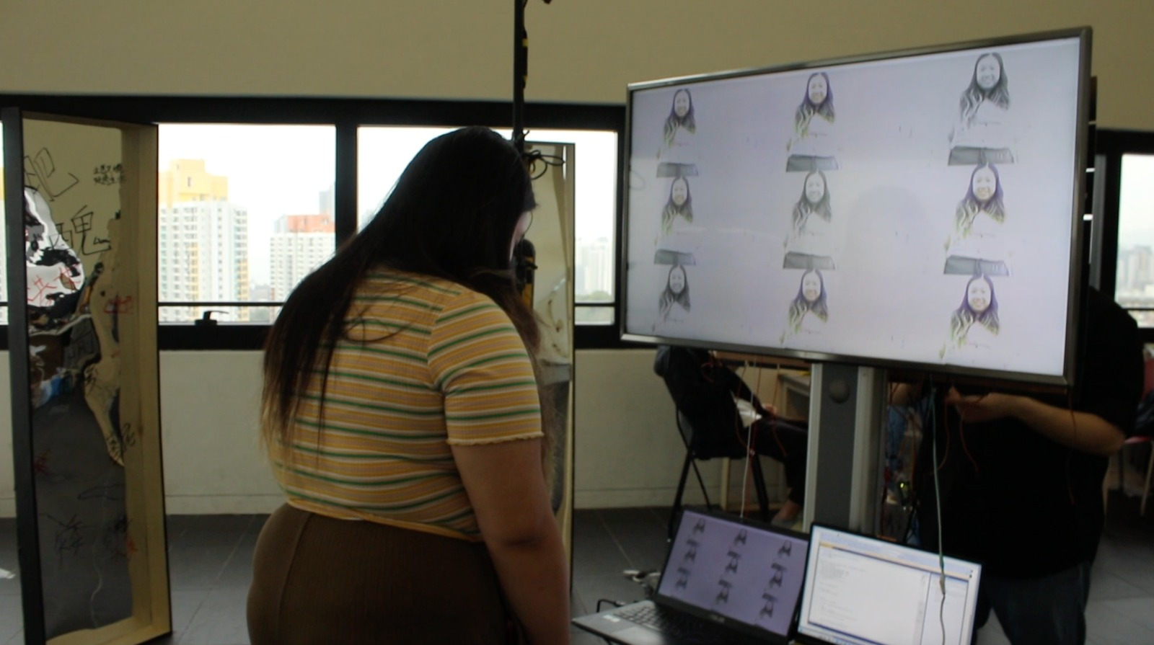
TV Monitor
Divided the camera into 9 grids
Applying different visual effects
grayscale/saturation/contrast/
highlights/shadows
And decreases the frame-rate
EVA
Notes:
Frame-rate
Cv2 library
Diff effect
grayscale/saturation
9 grids

Slide 16
Emotion
Flow
self-reflection: lost, searched, self-reflection
Feel
amazed by the transformation of their own appearance
thousands of selves with different images through the eyes of others
seventy "I" in it, but they are all real "I" and the same "I"

Slide 17
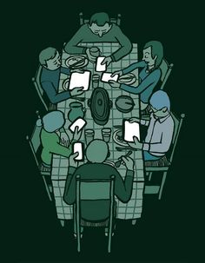
04.
Reflection
Pitch deck
EVA

Slide 18
Problem #1
Combining arduino micro servos and face detection
Java and python language used
Library tested to control servos
Communication between python and arduino

Slide 19
Problem #2
Data transmitted from python to arduino
Bandwidth and bitrate
Encoding data before sending
Data type conversion

Slide 20
Problem #3
Electricity and power supply
70 servos require stable voltage and high current supply
Soldering technique required to chain up pca9685

Slide 21
Problem #4
Smoothness of mirror plates
Angle mapping between the servos and 3D print component
The angle pulse value error of servos

Slide 22
Problem #5
Limitation of the current library used
Stability affected by brightness
Image detection affected by colors
Overflow of serial.port transmission

Slide 23
Problem #6
Quality of wood
Easily damage
Black enamel be color

Slide 24
Problem #7
Other Mirror’s design
Different height of people
Position of surface design
Clarity of mirror

Slide 25
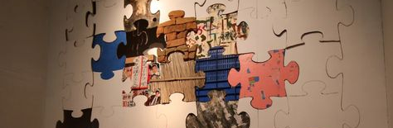
Discovery
EVA

Slide 26
Every artwork is based on a central idea or message that the creators want to deliver.
An artwork with beautiful decoration but weak idea is not a good work
Notes:
Fusion of artistic and coding
Hardware
softwear

Slide 27
Making art is more complicated than it looks
The genre interactive installation art is a fusion of different subjects
Computer science
Installation art
Electronics microcontroller
Notes:
Fusion of artistic and coding
Hardware
softwear

Slide 28
Making an art is more complicated than it looks
It combined multiple elements like -communicating with different departments
-requesting for venue
-budget controlling
-resources allocating and shipping
-well planning on the timeline
-good idea
Notes:
Fusion of artistic and coding
Hardware
softwear

Slide 29
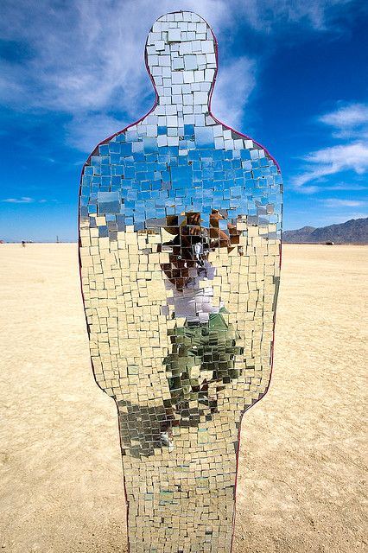
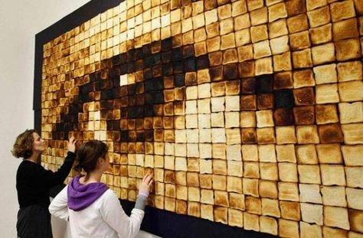
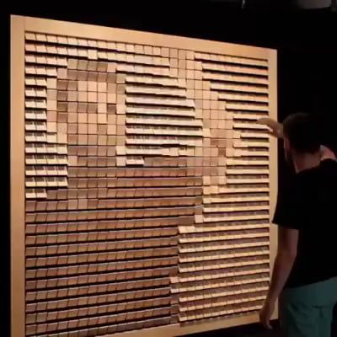
Future work
Do more interactive project
Interested on making arts and electronic and programing

Slide 30
Thanks
Q&A section~
Pitch deck
EVA

